Slide 1

Welcome to Class XII
For The Course
English Core
( Paper Code No. 301)
HPD/PPS/XII

Slide 2

The Last Lesson- Alphonse Daudet
HPD/PPS/XII
Alphonse Daudet
About The Author He is a French short-story writer and novelist, remembered for his Lettres de mon moulin (1866), light stories of southern France, and his egocentric hero Tartarin from Tartarin de Tarascon (1872) - the boastful, loud, vulgar 'Don Quixote' from the Midi. Alphonse Daudet, who has been called “the French Dickens”, published also under the influence of the Goncourt brothers and Zola such serious books as Fromont jeune et Risler aîné (1874), Jack (1876), and Sapho (1884), which had connections to Alexandre Dumas' (fils) The Lady of the Camillas (1848)
His own life the author depicted in Trente ans de Paris (1888) and Souvenirs d'un homme de lettres (1888). Le Petit Chose (1868) was a semiautobiographical novel about the author´s childhood years. During the last period of his life, Daudet suffered from the consequences of a venereal disease, which he had caught from a lectrice de la cour, a woman employed to read alout at the court of Napoleon III. Eventually it led to locomotor ataxia, a disease that produced violent, uncontrolled spasms and flashes of pain. The famous neurologist Jean-Martin Charcot, today best remembered for his work on hypnosis and hysteria, declared him "lost," but Daudet outlived him by three years. Charcot was one of regular visitors at the Daudet's weekly Thursday night gatherings.
"Fear of an attack: shooting pains that either nail me to the spot, or twist me around so that my foot pumps up and down like a knife-grinder's", Daudet described in the posthumously published book, entitled La Doulou. (In the Land of Pain, edited and translated by Julian Barnes, 2002, p. 5) This collection of notes contains an account of his sufferings, but he did not name the disease in this or other writings. Moreover, Daudet never mentioned of his son Léon's (1867-1942) subsequent development of the disease.

Slide 3

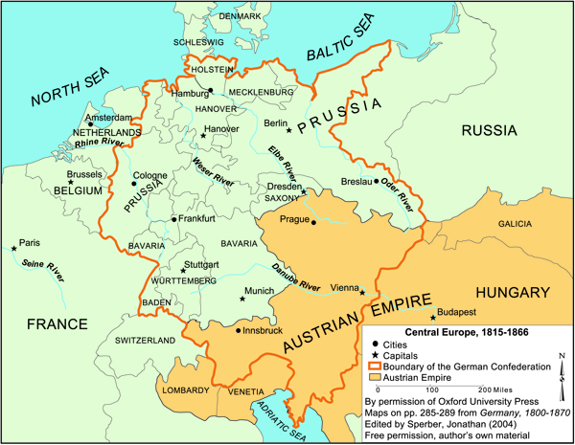
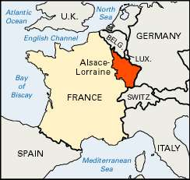
Short Description Of the Text.
The prose ‘The Last Lesson’ written by Alphonse Daudet narrates about the year 1870 when the Prussian forces under Bismarck attacked and captured France The French districts of Alasce and Lorraine went into Prussian hands. The new Prussian rulers discontinued the teaching of French in the schools of these two districts. The French teachers were asked to leave. M. Hamel, the French was transferred and could not remain in his old school. The story depicts the pathos of the whole situation about how people feel in not learning their language and losing as asset in M. Hamel.
HPD/PPS/XII

Slide 4

Main Points
Franz started for school very late.
He feared a scolding from M. Hamel as he had not prepared his lesson on participles.
When he reached his school, he found it unusually quiet.
Generally there used to be a great hustle at school in the morning.
He opened the door and went inside the classroom before everybody. He was frightened.
But nothing happened. M. Hamel, his teacher, very kindly asked him to go to his place quickly.
At last M. Hamel broke a shocking news to his student.
A new teacher would come to teach German.
Mr. Hamel called upon his students and the village-elders to guard French among themselves and never to forget it.
He declared that French was the most beautiful language in the world.
M. Hamel wanted to speak but couldn’t.
Something chocked him.
He took a piece of chalk and wrote on the blackboard as large as he could: ‘Long Live France’
HPD/PPS/XII

Slide 5
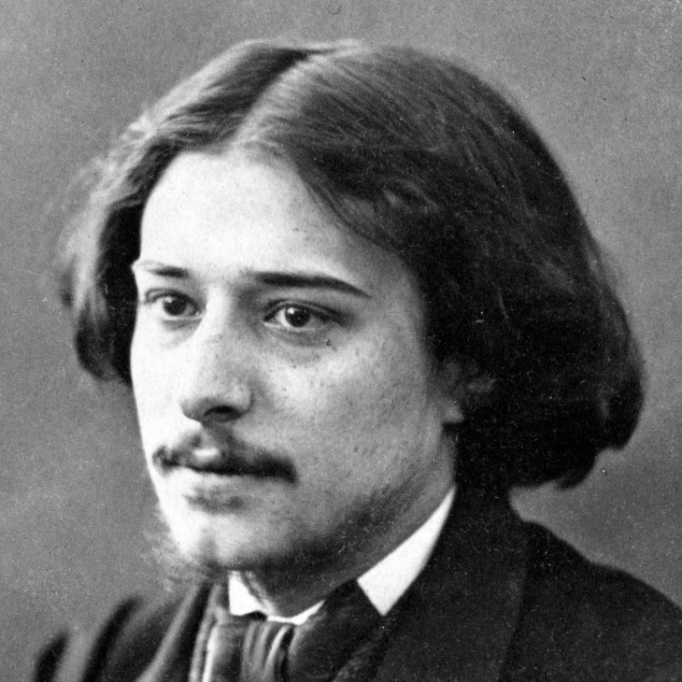
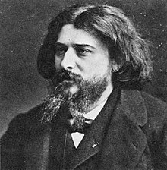
Read the Text
Click on this Sound and Listen to the Recorded Reading

Slide 6

Theme and Sub- Themes
Theme of the Unit
The Pain that is inflicted on the people of a territory by its conquerors by taking away the right to study or speak their own language
Sub- Theme
Student and teacher attitudes to learning and teaching

Slide 7
HPD/PPS/XII
Notice these expressions in the text. Infer their meanings from the context.
in great dread of -“ fearful in anticipation of something
counted on -“ to rely or trust on somebody/something
thumbed at the edges - “ worn or soiled edges caused by frequent handling
in unison -“ something happening or being done at the same time
a great bustle -“ an excited (and often noisy) activity or a rapid, active commotion
reproach ourselves with - “ to express disapproval, criticism, or disappointment
Assignment: Use these above expressions in your own sentences.

Slide 8
HPD/PPS/XII
Talking About The Text
Question 1: When a people are enslaved, as long as they hold fast to their language it is as if they had the key to their prison. Can you think of examples in history where a conquered people had their language taken away from them or had a language imposed on them?
Answer: Some examples of the native language taken away from its people and/or imposition of the language of the conqueror are:
Portuguese becoming the lingua franca of Angola.
(b) English imposed on the various Celtic peoples.
(c) Spanish imposed on the Basques and the Catalans.
(d) Turkish imposed on the Kurds.
Add More Examples of Your Own
Question 2: What happens to a linguistic minority in a state? How do you think they can keep their language alive? For example:
Punjabis in Bangalore, Tamilians in Mumbai, Kannadigas in Delhi, Gujaratis in Kolkata
Open Ended Question
Question 3:Is it possible to carry pride in one’s language too far? Do you know what ‘linguistic chauvinism’means?
Answer: Yes, it is possible to carry pride in one’s language too far if one is fond of one’ s own language at the cost of others. Indifference towards other languages is not healthy for any democracy like India.
When the sense of belonging to one’s own language crosses the thin line between pride and proud it becomes linguistic chauvinism. If people feel good about their languages and traditions, they must have tolerance for other languages too. Everybody has the right to follow the religion as well as speak the language as per his/her desire. In fact, it is disparaging to distort the names of communities, for example, Bongs for Bengalis, Gujju for Gujratis, etc.(This question is to be answered on the basis of students’ own understanding and experience. However, a model answer has been provided for students’ reference)

Slide 9
Question 1:
English is a language that contains words from many other languages. This inclusiveness is one of the reasons it is now a world language, for example:
petite – French, kindergarten – German,
capital – Latin democracy – Greek ,
bazaar – Hindi
Take Help of a good dictionary, software/ app of Dictionary
Find out the origin of the following words. Tycoon, tulip, logo, bandicoot, barbecue, veranda, robot, zero, ski, trek
( Dictionary and Mobile Work- Add Another 20 Words and their Origin excluding above)
HPD/PPS/XII

Slide 10
Read this sentence.
M. Hamel had said that he would question us on participles.
In the sentence above, the verb form ‘had said’ in the first part is used to indicate an ‘earlier past.’ The whole story is narrated in the past. M. Hamel saying happened earlier than the events in this story. This form of the verb is called the past perfect.
Pick out five sentences from the story with this form of verb and say why this form has been used.
Answer: In the following sentences, two activities of past, occurring at two different points of time in the past, are indicated. The one that happens earlier takes the had + past form of verb (V₃), while the one that follows it takes the simple past form of verb (V₂). (A model answer has been provided for students’ reference. It is strongly recommended that students prepare the answer on their own.)
Sentences in past perfect form | Reason/ Explanation
I had counted on the commotion to get to my desk without being seen; but, of course, that day everything had to be as quiet as Sunday morning.
Not till then, when I had got a little over my fright, did I see that our teacher had on his beautiful green coat on prize days.
Hauser had brought an old primer, thumbed at the edge, and he held it open on his knees with his great spectacles lying across the pages.
It was because they were sorry, too, that they had not gone to school more.
My books, that had seemed such a nuisance â€¦ were old friends now that I couldnâ€™t give up. | .
HPD/PPS/XII

Slide 11
WRITING SKILLS ASSIGNMENT
Question 1
Write a notice for your school bulletin board. Your notice could be an announcement of a forthcoming event, or a requirement to be fulfilled, or a rule to be followed.
Question 2
Write a paragraph of about 100 words arguing for or against having to study three languages at school.
Question 3:
Have you ever changed your opinion about someone or something that you had earlier liked or disliked? Narrate what led you to change your mind
HPD/PPS/XII

Slide 12
Things to Do Activity
HPD/PPS/XII
Collect Information About
(a) Linguistic human rights
(b) Constitutional guarantees for linguistic minorities in India
You may go to the internet, interview people, consult reference books or visit a library.
2. Complete this survey Form. (Talk to your Classmates, Neighbours, relatives and fill in the information as shown below . Prepare a separate Full scape/ A 4 Size sheet for it
S. No. | Languages you know | Home Language | Naighbourhood Language | City/ Town Language | School Language
1
2
3
4
5
6
7

Slide 13
FEEL PROUD ABOUT
YOUR OWN LANGUAGE
AND RESPECT
OTHER’S LANGUAGE

